Slide 1
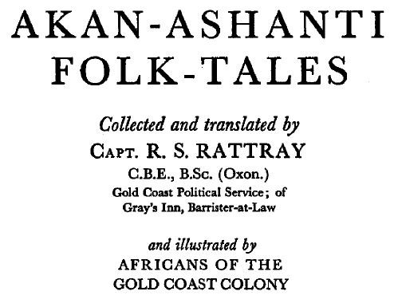
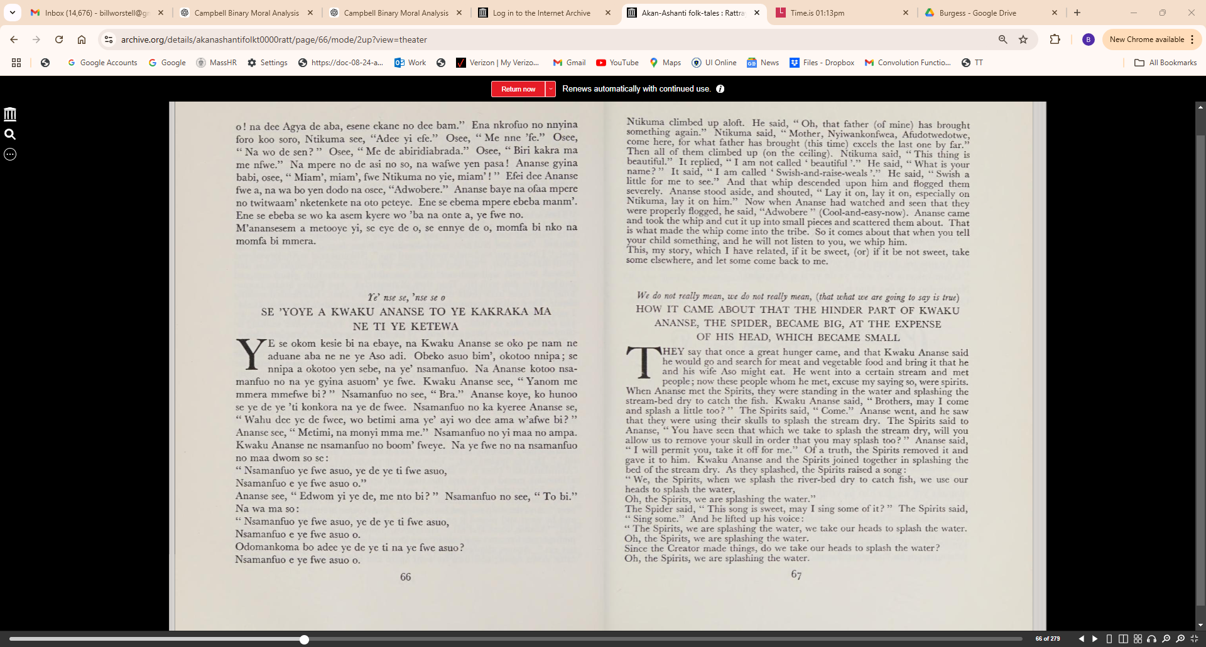

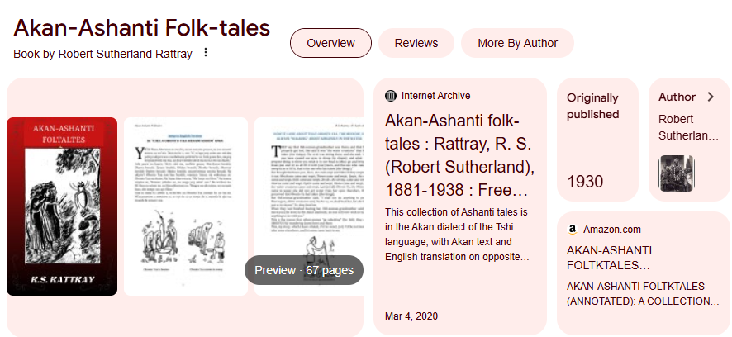
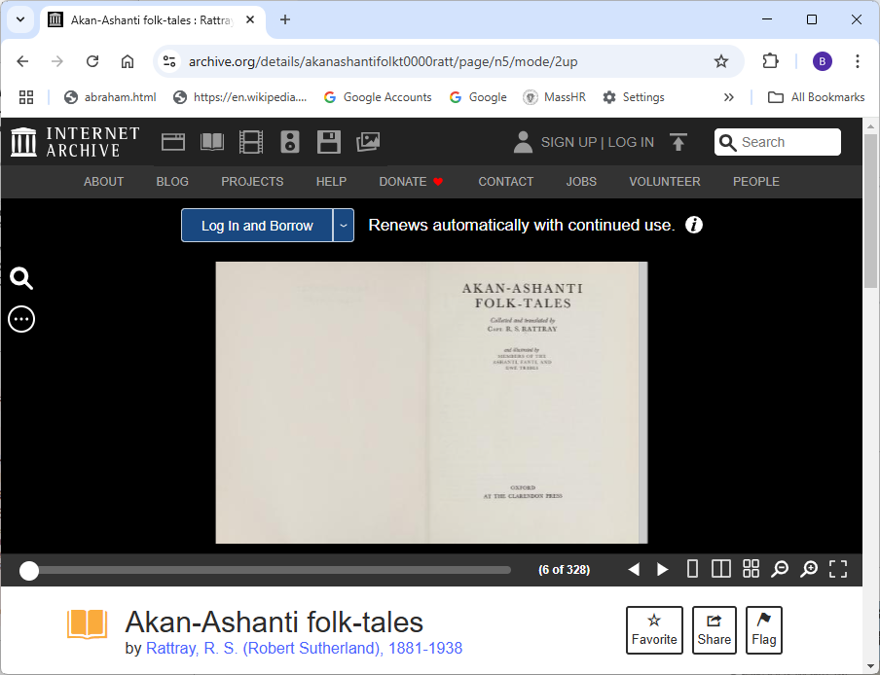
Demo Source Material:
https://archive.org/details/akanashantifolkt0000ratt/page/n5/mode/2up

Slide 2
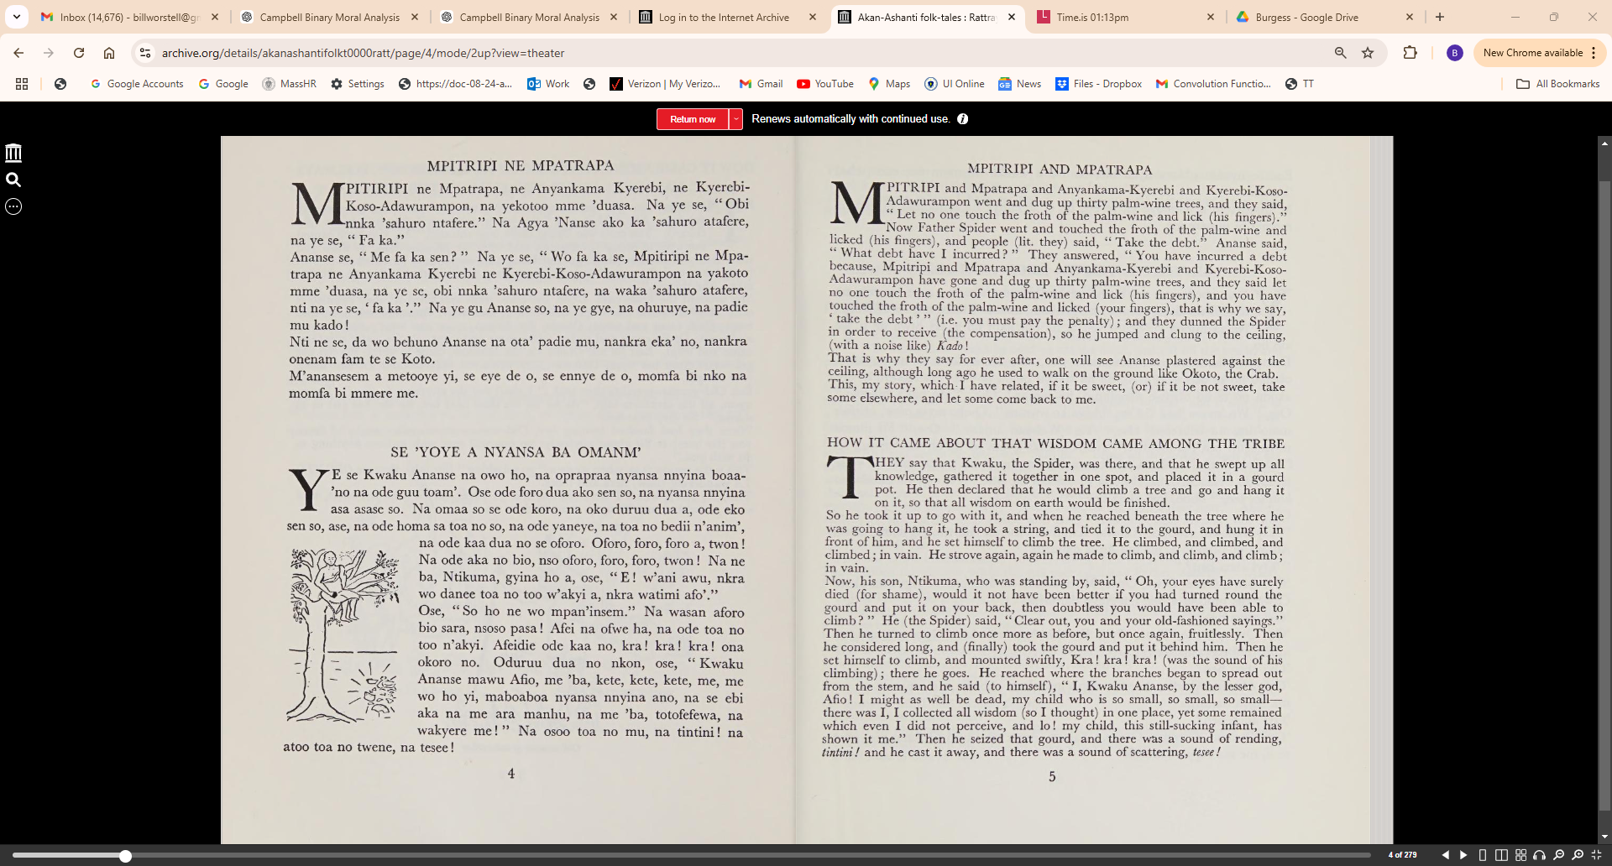

Slide 3
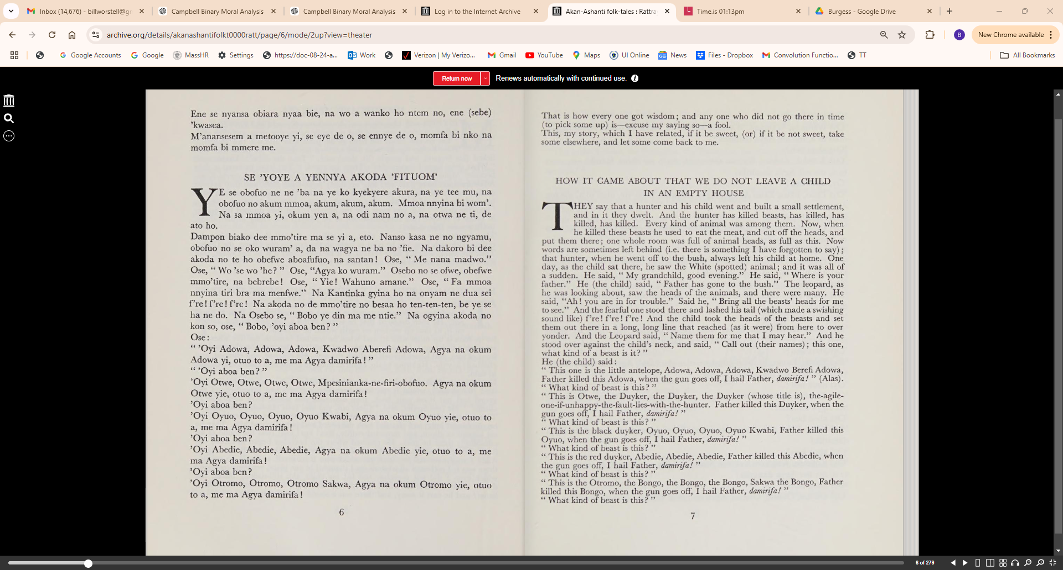

Slide 4
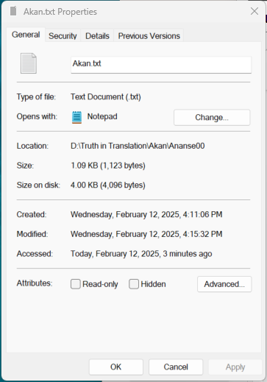
SE 'YOYE A NYANSA BA OMANM'
YE se Kwaku Ananse na owo ho, na oprapraa nyansa nnyina boaa­ 'no na ode guu toam'. Ose ode foro dua
ako sen so, na nyansa nnyina asa asase so. Na omaa so se ode koro, na oko duruu dua a, ode eko
sen so, ase, na ode homa sa toa no so, na ode yaneye, na toa no bedii n' anim', na ode kaa dua no
se oforo. Oforo, foro, foro a, twon ! Na ode aka no bio, nso oforo, foro, foro, twon! Na ne ba,
Ntikuma, gyina ho a, ose, "E ! w'ani awu, nkra wo danee toa no too w'akyi a, nkra watimi afo'."
Ose, "So ho ne wo mpan'insem." Na wasan aforo bio sara, nsoso pasa ! Afei na ofwe ha, na ode toa no
too n'akyi. Afeidie ode kaa no, kra! kra ! kra ! ona okoro no. Oduruu dua no nkon, ose, "Kwaku
Ananse mawu Afio, me 'ba, kete, kete, kete, me, me wo ho yi, maboaboa nyansa nnyina ano, na se ebi
aka na me ara manhu, na me 'ba, totofefewa, na wakyere me! " Na osoo toa no mu,. na tintini ! na
atoo toa no twene, na tesee ! Ene se nyansa obiara nyaa bie, na wo a wanko ho ntem no, ene (sebe)
'kwasea. M'anansesem a metooye yi, se eye de o, se ennye de o, momfa bi nko na
momfa bi mmere me.

Slide 5
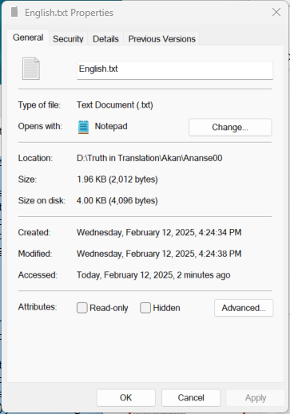
HOW IT CAME ABOUT THAT WISDOM CAME AMONG THE TRIBE
THEY say that Kwaku, the Spider, was there, and that he swept up all
knowledge, gathered it together in one spot, and placed it in a gourd
pot. He then declared that he would climb a tree and go and hang it
on it, so that all wisdom on earth would be finished.
So he took it up to go with it, and when he reached beneath the tree where he
was going to hang it, he took a string, and tied it to the gourd, and hung it in
front of him, and he set himself to climb the tree. He climbed, and climbed, and
climbed; in vain. He strove again, again he made to climb, and climb, and climb;
in vain.
Now, his son, Ntikuma, who was standing by, said, " Oh, your eyes have surely
died (for shame), would it not have been better if you had turned round the
gourd and put it on your back, then doubtless you would have been able to
climb? " He (the Spider) said, "Clear out, you and your old-fashioned sayings."
Then he turned to climb once more as before, but once again, fruitlessly. Then
he considered long, and (finally) took the gourd and put it behind him. Then he
set himself to climb, and mounted swiftly, Kra! kra! kra! (was the sound of his
climbing); there he goes. He reached where the branches began to spread out
from the stem, and he said (to himself), " I, Kwaku Ananse, by the lesser god,
Afio! I might as well be dead, my child who is so small, so small, so small
there was I, I collected all wisdom (so I thought) in one place, yet some remained
which even I did not perceive, and lo! my child, this still-sucking infant, has
shown it me." Then he seized that gourd, and there was a sound of rending,
tintini! and he cast it away, and there was a sound of scattering, tesee!
That is how every one got wisdom; and any one who did not go there in time
(to pick some up) is-excuse my saying so-a fool.
This, my story, which I have related, if it be sweet, (or) if it be not sweet, take
some elsewhere, and let some come back to me.

Slide 6
Line-by-Line Parallel Text Alignment Users see the source (Akan) text alongside its translation (English), with clear links between each line
AKAN | ENGLISH
Ye' nse se, 'nse se o | We do not really mean, we do not really mean, (that what we are going to say is true)
SE 'YOYE A NYANSA BA OMANM' | HOW IT CAME ABOUT THAT WISDOM CAME AMONG THE TRIBE
YE se Kwaku Ananse na owo ho, na oprapraa nyansa nnyina boaa­ 'no na ode guu toam'. | THEY say that Kwaku, the Spider, was there, and that he swept up all knowledge, gathered it together in one spot, and placed it in a gourd pot.
Ose ode foro dua ako sen so, na nyansa nnyina asa asase so. | He then declared that he would climb a tree and go and hang it on it, so that all wisdom on earth would be finished.
Na omaa so se ode koro, na oko duruu dua a, ode eko sen so, ase, na ode homa sa toa no so, na ode yaneye, na toa no bedii n' anim', na ode kaa dua no se oforo. | So he took it up to go with it, and when he reached beneath the tree where he was going to hang it, he took a string, and tied it to the gourd, and hung it in front of him, and he set himself to climb the tree.
Oforo, foro, foro a, twon ! | He climbed, and climbed, and climbed; in vain.
Na ode aka no bio, nso oforo, foro, foro, twon! | He strove again, again he made to climb, and climb, and climb;in vain.
Na ne ba, Ntikuma, gyina ho a, ose, "E ! w'ani awu, nkra wo danee toa no too w'akyi a, nkra watimi afo'." | Now, his son, Ntikuma, who was standing by, said, " Oh, your eyes have surely died (for shame), would it not have been better if you had turned round the gourd and put it on your back, then doubtless you would have been able to climb? "
Ose, "So ho ne wo mpan'insem." | He (the Spider) said, "Clear out, you and your old-fashioned sayings."
Na wasan aforo bio sara, nsoso pasa ! | Then he turned to climb once more as before, but once again, fruitlessly.
Afei na ofwe ha, na ode toa no too n'akyi. | Then he considered long, and (finally) took the gourd and put it behind him.
Afeidie ode kaa no, kra! kra ! kra ! ona okoro no. | Then he set himself to climb, and mounted swiftly, Kra! kra! kra! (was the sound of his climbing); there he goes.
Oduruu dua no nkon, ose, "Kwaku Ananse mawu Afio, me 'ba, kete, kete, kete, me, | He reached where the branches began to spread out from the stem, and he said (to himself), " I, Kwaku Ananse, by the lesser god, Afio! I might as well be dead, my child who is so small, so small, so small there was I.
me wo ho yi, maboaboa nyansa nnyina ano, na se ebi aka na me ara manhu, na me 'ba, totofefewa, na wakyere me! " | I collected all wisdom (so I thought) in one place, yet some remained which even I did not perceive, and lo! my child, this still-sucking infant, has shown it me."
Na osoo toa no mu, na tintini ! | Then he seized that gourd, and there was a sound of rending, tintini!
naatoo toa no twene, na tesee ! | and he cast it away, and there was a sound of scattering, tesee!
Ene se nyansa obiara nyaa bie, na wo a wanko ho ntem no, ene (sebe) 'kwasea. | That is how every one got wisdom; and any one who did not go there in time (to pick some up) is-excuse my saying so-a fool.
M'anansesem a metooye yi, se eye de o, se ennye de o, momfa bi nko namomfa bi mmere me. | This, my story, which I have related, if it be sweet, (or) if it be not sweet, take some elsewhere, and let some come back to me.

